Slide 1
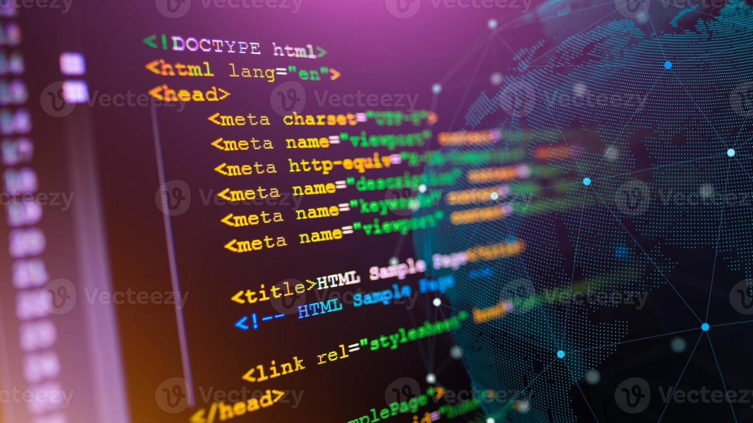
SURI FORUM Developing Secure Web Applications for Bitcoin Transactions
Eddy Koundjou Yem, Henry Omisakin, Mirabel Enofe​
Professor Tankeh and Mentor Audu

Slide 2
Table of contents
01
02
03
04
05
06
Introduction
Project Goals
Methods
Accomplishments
Discussion
Conclusion

Slide 3
Table of contents
07
08
Future Goals
Q & A

Slide 4
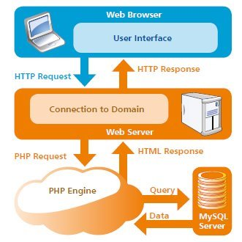
01
Introduction

Slide 5
Introduction
Research Focus: Web Development Tools and their application in the banking sector
Specific Target: Bitcoin transactions
Technologies and Tools:
VS Code: Code Editor
HTML: Front-End Development
MySQL: Database Management
Client-Server Architecture: Backend Services
Javascript: Client-Side Scripting

Slide 6

02
Project Goals

Slide 7
Project Goals
The overall goals of our project are:
Building a web page that can simulate bitcoin transactions
Front-End: Create a friendly sign-on website
Back-End: Implement functionality for managing user balance

Slide 8
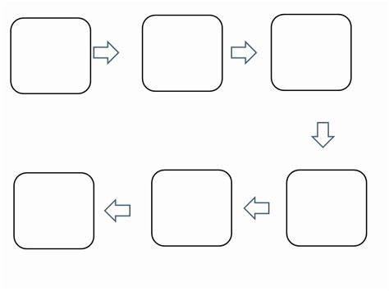
03
Methods

Slide 9
Methods
Research Methods that were implemented:
BSU Discovery
Google Scholars
Online resources for the different technologies

Slide 10

04
Accomplishments

Slide 11
Accomplishments
Downloaded necessary programs to conduct our research
Git Bash
MySQL
Visual Studio Code
Maintained stable team communication and kept on track

Slide 12

05
Discussion

Slide 13
Discussion
Challenges that were faced ​
Learning new languages (HTML, Javascript, MySQL)​
Understanding blockchain and how it applies to our project (Bitcoin, Web3)​
How they were resolved ​
Online Resources and Research ​
Relying on the team for more information

Slide 14

06
Conclusion

Slide 15
Conclusion
Research Project
Tools & Technologies
Research Methods
Explore web development tools and their application in the banking sector, specifically focusing on Bitcoin transactions.​
VS Code​
HTML​
MySQL​
JavaScript​
Client + Server​
Research Papers and other online resources

Slide 16

Goals for the next 2-3 weeks
07

Slide 17
Goals for the 2-3 weeks
Front End Development​
Develop a front end design that is aesthetic, usable, and secure​
Back End Development​
Work on the integration of MySQL ​
Develop and test a Bitcoin transaction functionality ​
Blockchain and Web3 Integration​
Further research into Web3 and Bitcoin​
Look into applying security measures into our project

Slide 18
Q & A

